Slide 1
Tournament Generator Start your own Tournament now!
Information System Development
Presentation group project
Alexander Büchel, Fabio Hilti, Lucy Gannon

Slide 2

Agenda
Project Group & Project Aim
Project Description
Live Demonstration
Code Quality
Challenges
Highlights
Version Control

Slide 3

Project Group & Project Aim
Project Group
Alexander, Fabio & Lucy
Little to no experience in Phyton/Django
No Coding-Background
Project Aim
Creative and functional web project
Greater Understanding of coding
Tournament Generator

Slide 4
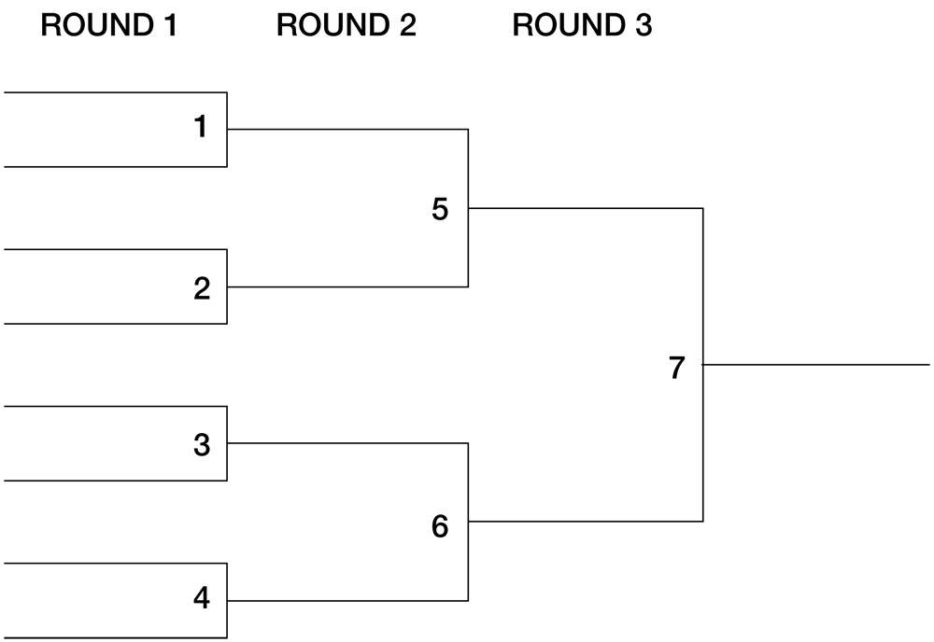
Project Description
Our Choice: Tournament Generator
Sport Competition or Fun
Creation of Tournament Brackets
Size for 8, 16 or 32 Teams
Creation of individual teams
Easy to use & understand for end-user
Notes:
Source Picture:
https://www.baggo.com/templates/default/images/bracket.png

Slide 5

Live Demonstration

Slide 6
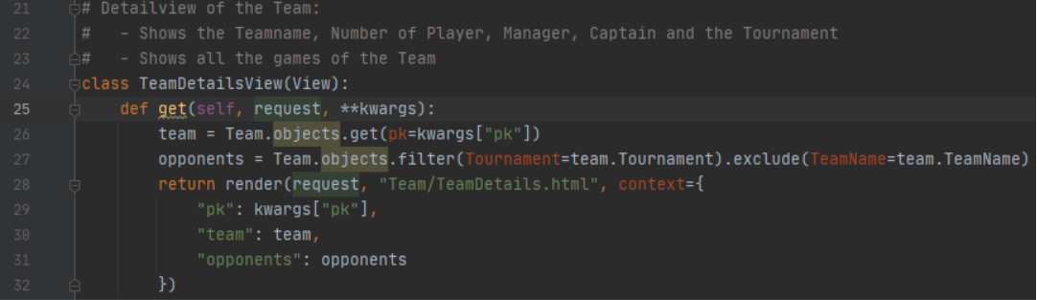
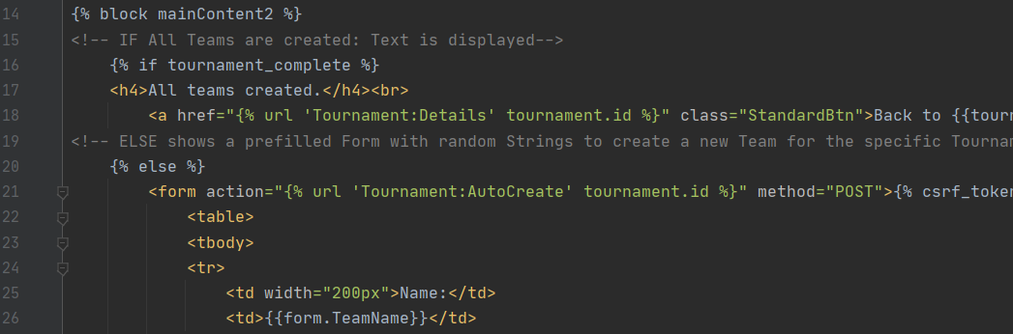
Code Quality

Slide 7

Challenges
Successes
Fulfilled all the major requirements of all stakeholders
Pleasant and Intuitive Design
Quality Code
Challenges
Communication
Differences in skill
Challenge of the Tournament Tree

Slide 8

Highlights
Tournament Tree
Autofill
Achievements:
Nice project with no experience
Almost all requirements fulfilled

Slide 9

Version Control
https://github.com/BuecAle/TournamentGenerator_ISD/
Notes:
Image source:
https://pngimg.com/uploads/github/github_PNG15.png

Slide 10

END OF
PRESENTATION

